Slide 1
Device Security Scenarios Part 1: Identity and Device management using Azure Active Directory & Windows Hello
Dec 2018
M3
Microsoft 365 Device Series

Slide 2
Agenda
User Identity Management Protection AAD
Risk-Based conditional access
Windows Hello for Business

Slide 3
User Identity Management Protection

Slide 4

Staying Secure with Windows 10
Attackers take advantage of periods between releases
Stay ahead of the attackers with continual Windows 10 improvements
Capability
Protection Gap
Time
Product Release
Threat sophistication
Notes:
We also need to look at changes to the overall security landscape. We used to be able to have a release of Windows every few years that established a strong security baseline – it would be patched if any security issues were found, but there would be no new security features added until the next release. That gave hackers the ability to take advantage of a protection gap between releases – they can continue to try to find vulnerabilities in the design.
This protection gap is especially problematic in this age of more sophisticated attacks being perpetrated by very large hacking organizations – it’s not just “script kiddies” in basements trying to cause havoc, it can be hundreds or thousands of people making a concerted effort to steal information (or worse).
But now with more frequent releases, that protection gap shrinks considerably, almost disappearing. We’re releasing new security features with each new Windows 10 feature update, in our ongoing quest to stay steps ahead of the bad guys. This makes it very hard for the bad guys – so much so that they will likely seek out easier targets (for example, users who can be tricked).

Slide 5
How do we enable productivity without compromising security?
SECURITY
THE PROBLEM:
OR
OPPORTUNITY
Productivity
On-premises
Notes:
© 2014 Microsoft Corporation. All rights reserved. MICROSOFT MAKES NO WARRANTIES, EXPRESS, IMPLIED OR STATUTORY, AS TO THE INFORMATION IN THIS PRESENTATION.
11/27/2018 11:57 PM
5

Slide 6
How do we enable productivity without compromising security?
THE PROBLEM:
SECURE
Productivity
OPPORTUNITY
On-premises
Notes:
© 2014 Microsoft Corporation. All rights reserved. MICROSOFT MAKES NO WARRANTIES, EXPRESS, IMPLIED OR STATUTORY, AS TO THE INFORMATION IN THIS PRESENTATION.
11/27/2018 11:57 PM
6

Slide 7


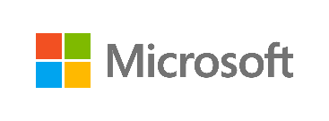
OUR PROTECTION APPROACH
Microsoft Secure
PLATFORM
Ensuring security to enable your digital transformation through a comprehensive platform, unique intelligence, and broad partnerships

Slide 8
Identity & Access Management Protect users’ identities and control access to valuable resources based on user risk level
OUR UNIQUE APPROACH
PLATFORM
Threat Protection Protect against advanced threats and recover quickly when attacked
Information Protection Ensure documents and emails are seen only by authorized people
Security Management Gain visibility and control over security tools

Slide 9
WHY IDENTITY IS IMPORTANT?
81%
73%
80%
of breaches are caused by credential theft
of passwords are duplicates
of employees use non-approved apps for work
Notes:
© Microsoft Corporation. All rights reserved.
11/27/2018 11:57 PM
9

Slide 10

The world before MOBILITY & CLOUD
users
devices
apps
data
On-premises /
Private cloud
Notes:
© Microsoft Corporation. All rights reserved. MICROSOFT MAKES NO WARRANTIES, EXPRESS, IMPLIED OR STATUTORY, AS TO THE INFORMATION IN THIS PRESENTATION.
11/27/2018 11:57 PM
10

Slide 11




CLOUD APPS & SAAS SERVICES
On-premises /
Private cloud
Notes:
© Microsoft Corporation. All rights reserved. MICROSOFT MAKES NO WARRANTIES, EXPRESS, IMPLIED OR STATUTORY, AS TO THE INFORMATION IN THIS PRESENTATION.
11/27/2018 11:57 PM
11

Slide 12



MOBILE AND PERSONAL DEVICES
On-premises /
Private cloud
Notes:
© Microsoft Corporation. All rights reserved. MICROSOFT MAKES NO WARRANTIES, EXPRESS, IMPLIED OR STATUTORY, AS TO THE INFORMATION IN THIS PRESENTATION.
11/27/2018 11:57 PM
12

Slide 13
ORGANIZATION & SOCIAL IDENTITIES
On-premises /
Private cloud
Notes:
© Microsoft Corporation. All rights reserved. MICROSOFT MAKES NO WARRANTIES, EXPRESS, IMPLIED OR STATUTORY, AS TO THE INFORMATION IN THIS PRESENTATION.
11/27/2018 11:57 PM
13

Slide 14
On-premises /
Private cloud
Notes:
© Microsoft Corporation. All rights reserved. MICROSOFT MAKES NO WARRANTIES, EXPRESS, IMPLIED OR STATUTORY, AS TO THE INFORMATION IN THIS PRESENTATION.
11/27/2018 11:57 PM
14

Slide 15
One strong identity
at the center of your business
On-premises /
Private cloud
Notes:
© Microsoft Corporation. All rights reserved. MICROSOFT MAKES NO WARRANTIES, EXPRESS, IMPLIED OR STATUTORY, AS TO THE INFORMATION IN THIS PRESENTATION.
11/27/2018 11:57 PM
15

Slide 16
Azure Active Directory Identity Protection

Slide 17
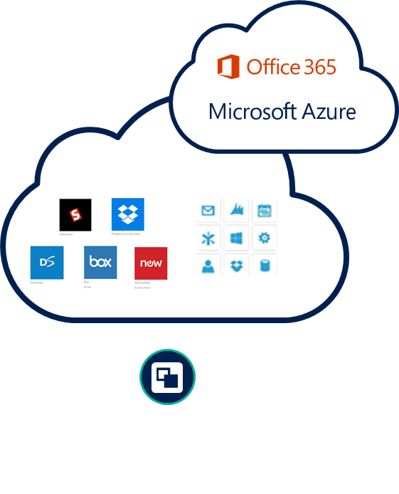
Identity-driven security
CLOUD-POWERED PROTECTION
Conditions
Actions
User, App sensitivity
Allow access or
Device state
User
Location
Enforce MFA per user/per app
Risk
Block access
MFA
NOTIFICATIONS, ANALYSIS, REMEDIATION, RISK-BASED POLICIES
CLOUD APP DISCOVERY
PRIVILEGED IDENTITY MANAGEMENT
IDENTITY PROTECTION
Notes:
https://play.google.com/store/apps/details?id=com.azure.authenticator&hl=en
https://itunes.apple.com/us/app/microsoft-authenticator/id983156458?mt=8

Slide 18


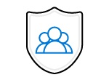
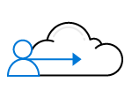

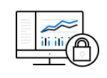
What is
Azure Active Directory?
User Identity Management
Intelligence-Driven Access Policies
Resource access protection
Multi-platform solution
An identity as a service provider aimed at organization users to provide and control access to cloud resources

Slide 19
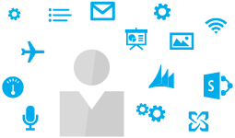

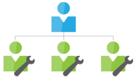
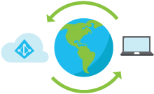
Azure Active Directory functionalities
Get seamless access to any application from
virtually any location or device
Collaborate securely with partners and customers
Increase IT efficiency and cut down help desk costs
Enhance security and respond to advanced
threats in real time
Notes:
Get seamless access to any application from virtually any location or device
By using one identity, users can launch all of their cloud applications from a personalised, web-based access panel or mobile app and have the same experience whether they’re working on Windows, Mac, Android or iOS devices. With the Azure AD Application Proxy, you can go beyond cloud applications and publish on-premises web applications to provide highly secure remote access and single sign-on.
Collaborate securely with partners and customers
Engage with users outside your organisation while maintaining control over your sensitive apps and data. It’s easier than ever for customers and partners to connect with your business using a simple sign-up experience that works with multiple identity providers, including Microsoft, LinkedIn, Google and Facebook. You can also use customisation options to modify the web and mobile experience to fit your brand.

Slide 20
Identity & Access Management Prove users are authorized and secure before granting access to apps and data
Protect at the front door
Simplify access to devices and apps
Safeguard your credentials
Notes:
EMS Overview
© 2014 Microsoft Corporation. All rights reserved. Microsoft, Windows, Surface and other product names are or may be registered trademarks and/or trademarks in the U.S. and/or other countries. The information herein is for informational purposes only and represents the current view of Microsoft Corporation as of the date of this presentation. Because Microsoft must respond to changing market conditions, it should not be interpreted to be a commitment on the part of Microsoft, and Microsoft cannot guarantee the accuracy of any information provided after the date of this presentation. MICROSOFT MAKES NO WARRANTIES, EXPRESS, IMPLIED OR STATUTORY, AS TO THE INFORMATION IN THIS PRESENTATION.
11/27/2018
20

Slide 21


Azure Multi-Factor Authentication: How it works
Mobile apps
Phone calls
Text messages

Slide 22
Authentication with Azure Active Directory Connect
More options than ever!
Identity Synchronization + Password Hash Synchronization+
Seamless SSO
Identity Synchronization + ADFS
Identity Synchronization + Pass-through Authentication + Seamless SSO
Microsoft Azure
Active Directory
User
Seamless SSO
ADFS
Seamless SSO
Identity synchronization
Pass-through
Authentication
Identity +
Password Hash synchronization
Identity synchronization
Notes:
https://blogs.technet.microsoft.com/enterprisemobility/2016/12/07/introducing-azuread-pass-through-authentication-and-seamless-single-sign-on/
https://docs.microsoft.com/en-us/azure/active-directory/connect/active-directory-aadconnect-sso
https://aka.ms/modernauthga
SaRA – Support and Recovery Assistant for O365
https://diagnostics.office.com/#/

Slide 23
Azure Active Directory
DEMOSTRATION

Slide 24
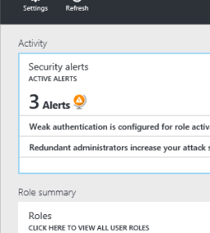
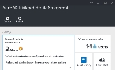
Protect privileged identities
Discover, restrict, and monitor privileged identities
Enforce on-demand, just-in-time administrative access when needed
Use Alert, Audit Reports and Access Review
Domain User
Global Admin.
Admin. privileges expire after a specified interval
Domain User
Notes:
EMS Overview
© 2014 Microsoft Corporation. All rights reserved. Microsoft, Windows, Surface and other product names are or may be registered trademarks and/or trademarks in the U.S. and/or other countries. The information herein is for informational purposes only and represents the current view of Microsoft Corporation as of the date of this presentation. Because Microsoft must respond to changing market conditions, it should not be interpreted to be a commitment on the part of Microsoft, and Microsoft cannot guarantee the accuracy of any information provided after the date of this presentation. MICROSOFT MAKES NO WARRANTIES, EXPRESS, IMPLIED OR STATUTORY, AS TO THE INFORMATION IN THIS PRESENTATION.
11/27/2018
24

Slide 25
Benefits: Privileged Identity Management
Reduces exposure to attacks targeting admins
Simplifies delegation
Increases visibility and finer-grained control
Removes unneeded permanent admin role assignments
Limits the time a user has admin privileges
Ensures MFA validation prior to admin role activation
Separates role administration from other tasks
Adds roles for read-only views of reports and history
Asks users to review and justify continued need for admin role
Enables least privilege role assignments
Alerts on users who haven’t used their role assignments
Simplifies reporting on admin activity
Notes:
VALUE PROPOSITION
Simple and secure partner access
Partner managed identities
Customer managed access
All partners large and small
And by apps I mean:
SaaS apps (Office 365, Salesforce, Box)
On-premises apps (claims aware only for preview)
Mobile or cloud apps
1. Bulk invite 1000’s of users at a time
2. Bulk add invited users to groups and applications
3. Partner managed credentials to access your resources
4. Email verified sign up for Azure AD accounts

Slide 26



Who is accessing? What is their role?
Is the account compromised?
Where is the user based? From where is the user signing in? Is the IP anonymous?
Which app is being accessed?
What is the business impact?
Is the device healthy? Is it managed?
Has it been in a botnet?
What data is being accessed?
Is it classified? Is it allowed off premises?
Notes:
EMS Overview
© 2014 Microsoft Corporation. All rights reserved. Microsoft, Windows, Surface and other product names are or may be registered trademarks and/or trademarks in the U.S. and/or other countries. The information herein is for informational purposes only and represents the current view of Microsoft Corporation as of the date of this presentation. Because Microsoft must respond to changing market conditions, it should not be interpreted to be a commitment on the part of Microsoft, and Microsoft cannot guarantee the accuracy of any information provided after the date of this presentation. MICROSOFT MAKES NO WARRANTIES, EXPRESS, IMPLIED OR STATUTORY, AS TO THE INFORMATION IN THIS PRESENTATION.
11/27/2018
26

Slide 27
POWERED BY MICROSOFT THREAT INTELLIGENCE
1.2B
devices scanned
each month
Shared threat
data from partners,
researchers and law
Enforcement
worldwide
Malware data
from Windows
Defender
Unique insights, informed by trillions of signals. This signal is leveraged across all of Microsoft’s security services
400B
emails analyzed
200+ global cloud consumer and
Commercial services
Botnet data from
Microsoft Digital
Crimes Unit
Enterprise
security for
90%
of Fortune 500
18+B
Bing web pages
scanned
750M+
Azure user
accounts
450B monthly authentications

Slide 28



AZURE AD
Conditional Access
IF
THEN
Allow access
User risk
Privileged user?
Credentials found in public?
Accessing sensitive app?
Unmanaged device?
Malware detected?
IP detected in Botnet?
Impossible travel?
Anonymous client?
High
Medium
Require MFA
11 TB
Low
Force password reset
******
per day
Session risk
High
Deny access
Medium
Low
Limit access

Slide 29

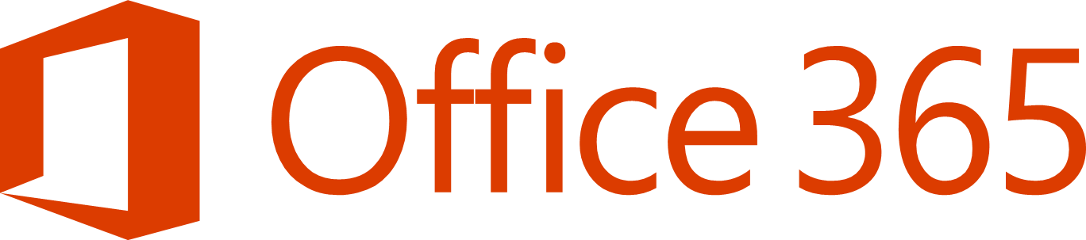


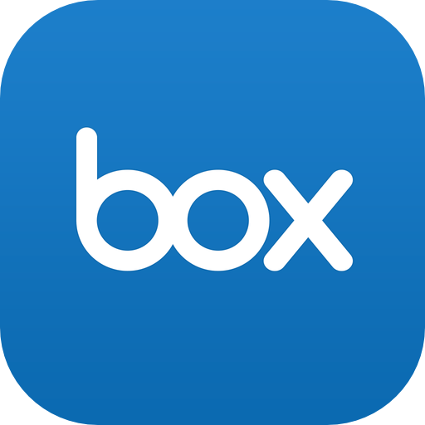


PROTECT ACCESS TO APPs
on-premises and in the cloud
LINE OF BUSINESS APPS
ON-PREMISES

Slide 30
USE DEVICE AUTHENTICATION to automatically provide access to apps
Office 365
Third party apps and clouds
Azure Active Directory
App in Azure
Microsoft Intune
Enterprise State Roaming
Intune/MDM auto-enrollment
Windows 10 Azure AD joined devices
On-premises apps
Active Directory
Notes:
EMS Overview
© 2014 Microsoft Corporation. All rights reserved. Microsoft, Windows, Surface and other product names are or may be registered trademarks and/or trademarks in the U.S. and/or other countries. The information herein is for informational purposes only and represents the current view of Microsoft Corporation as of the date of this presentation. Because Microsoft must respond to changing market conditions, it should not be interpreted to be a commitment on the part of Microsoft, and Microsoft cannot guarantee the accuracy of any information provided after the date of this presentation. MICROSOFT MAKES NO WARRANTIES, EXPRESS, IMPLIED OR STATUTORY, AS TO THE INFORMATION IN THIS PRESENTATION.
11/27/2018
30

Slide 31
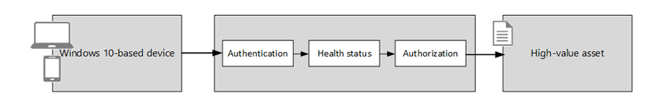
Platform Integrity
Health Attestation
Threat
Compromised devices proliferate malware and attack other resources and devices while connected to a network
Mitigation
Health Attestation
Enables enterprises to establish trust, based on hardware & software components of a managed device
Can be used to define rules for conditional access in compliance policies for Windows 10 devices
Configuration Options
Early-launch antimalware
Bitlocker
Secure Boot
Code Integrity
Notes:
Configuration Options
Early-launch antimalware - Early launch anti-malware (ELAM) protects your computer when it starts up and before third-party drivers initialize.
BitLocker - Windows BitLocker Drive Encryption is software that lets you encrypt all data stored on the Windows operating system volume.
Secure Boot - Secure Boot is a security standard developed by members of the PC industry to help make sure that your PC boots using only software that is trusted by the PC manufacturer.
Code Integrity - Code Integrity is a feature that improves the security of the operating system by validating the integrity of a driver or system file each time it is loaded into memory.
References
Health Attestation for Configuration Manager - https://technet.microsoft.com/en-us/library/mt651779.aspx

Slide 32

Conditional access
User attributes
User id
Group membership
ALLOW
Devices
Domain Joined
Compliant
Platform type (Windows, iOS, Android)
SSO
ENFORCE MFA
Microsoft Azure
ENROLL
Application
Per app policy
Client type (Web, Rich, mobile)
BLOCK
Location
IP Range
ADFS
Cloud and On-premises applications
AUDIT
Session
Risk
Session risk
User risk
BLOCK DOWNLOAD

Slide 33
Windows Hello for Business

Slide 34

Do your users struggle to remember complex passwords?
Do they have to juggle multiple credentials?
How can you simplify access to devices & apps?
Can you extend user identity for Office 365 or Windows to other apps?
Do you MFA every time you want to ensure secure access?
Notes:
EMS Overview
© 2014 Microsoft Corporation. All rights reserved. Microsoft, Windows, Surface and other product names are or may be registered trademarks and/or trademarks in the U.S. and/or other countries. The information herein is for informational purposes only and represents the current view of Microsoft Corporation as of the date of this presentation. Because Microsoft must respond to changing market conditions, it should not be interpreted to be a commitment on the part of Microsoft, and Microsoft cannot guarantee the accuracy of any information provided after the date of this presentation. MICROSOFT MAKES NO WARRANTIES, EXPRESS, IMPLIED OR STATUTORY, AS TO THE INFORMATION IN THIS PRESENTATION.
11/27/2018
34

Slide 35

With Windows Hello for Business you are the password

Slide 36
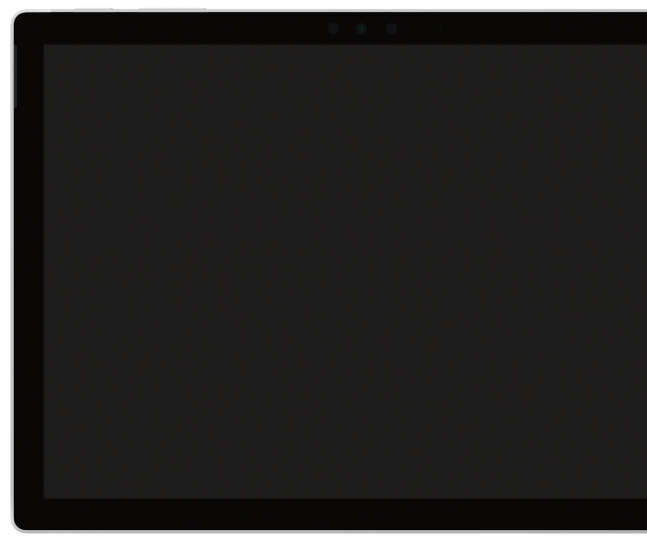
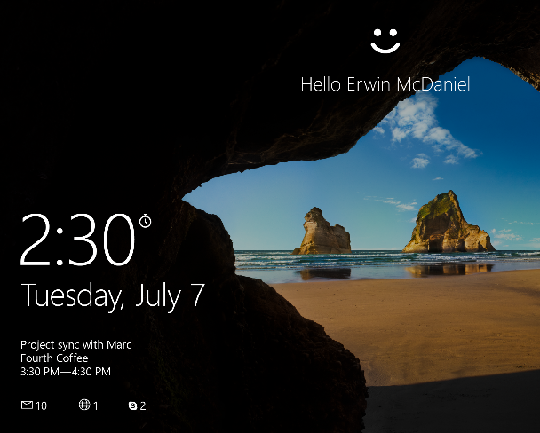
WINDOWS Hello for Business
Passwordless strong authentication via multiple factors
PC + PIN or Biometrics
PC + Companion Device
PC supported Biometrics: fingerprint & facial
Companion Device can support other biometrics options (e.g.: EKG)
Supported on any Windows 10 device
>100 devices supporting biometrics
Notes:
EMS Overview
© 2014 Microsoft Corporation. All rights reserved. Microsoft, Windows, Surface and other product names are or may be registered trademarks and/or trademarks in the U.S. and/or other countries. The information herein is for informational purposes only and represents the current view of Microsoft Corporation as of the date of this presentation. Because Microsoft must respond to changing market conditions, it should not be interpreted to be a commitment on the part of Microsoft, and Microsoft cannot guarantee the accuracy of any information provided after the date of this presentation. MICROSOFT MAKES NO WARRANTIES, EXPRESS, IMPLIED OR STATUTORY, AS TO THE INFORMATION IN THIS PRESENTATION.
11/27/2018
36

Slide 37
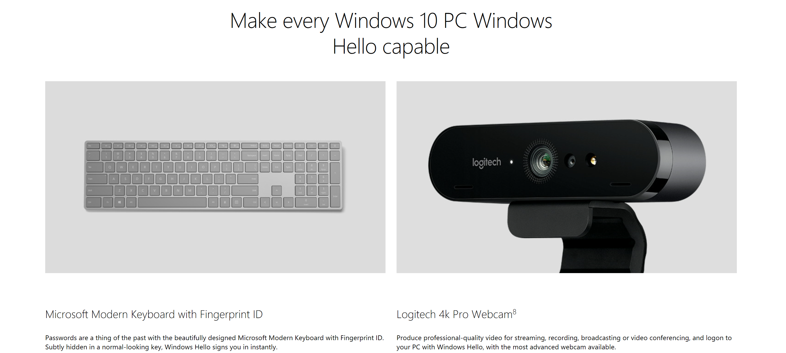

Slide 38
Windows Hello Companion Device Framework
Making WINDOWS Hello Work for Every Environment
Phone
Wearable
USB
Card

Slide 39
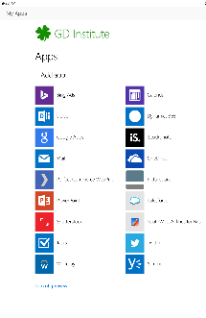

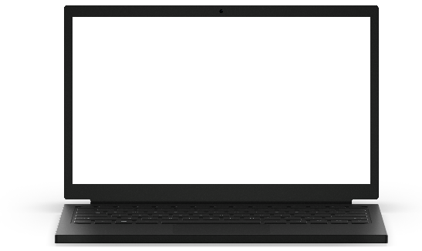
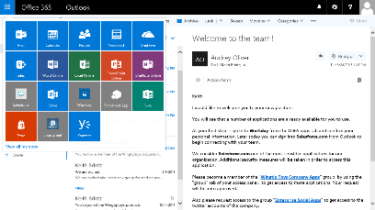
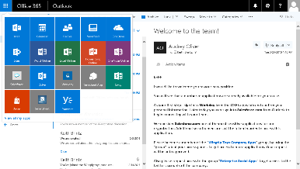

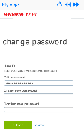
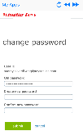
Access all your SaaS and on-premises apps
My apps portal
Integrated Office 365 app launching
Manage your account, apps, and groups
Self-service password reset
Application access requests
Notes:
EMS Overview
© 2014 Microsoft Corporation. All rights reserved. Microsoft, Windows, Surface and other product names are or may be registered trademarks and/or trademarks in the U.S. and/or other countries. The information herein is for informational purposes only and represents the current view of Microsoft Corporation as of the date of this presentation. Because Microsoft must respond to changing market conditions, it should not be interpreted to be a commitment on the part of Microsoft, and Microsoft cannot guarantee the accuracy of any information provided after the date of this presentation. MICROSOFT MAKES NO WARRANTIES, EXPRESS, IMPLIED OR STATUTORY, AS TO THE INFORMATION IN THIS PRESENTATION.
11/27/2018
39

Slide 40

Can you protect credentials against Pass-the-Hash and other similar classes of attacks?
Can you restrict and monitor the use of privileged credentials?
How do you protect user & administrator credentials ?
How are the credentials stored in your devices?
Notes:
EMS Overview
© 2014 Microsoft Corporation. All rights reserved. Microsoft, Windows, Surface and other product names are or may be registered trademarks and/or trademarks in the U.S. and/or other countries. The information herein is for informational purposes only and represents the current view of Microsoft Corporation as of the date of this presentation. Because Microsoft must respond to changing market conditions, it should not be interpreted to be a commitment on the part of Microsoft, and Microsoft cannot guarantee the accuracy of any information provided after the date of this presentation. MICROSOFT MAKES NO WARRANTIES, EXPRESS, IMPLIED OR STATUTORY, AS TO THE INFORMATION IN THIS PRESENTATION.
11/27/2018
40

Slide 41
How Hello protects credentials
Strong authentication via multiple factors
User credentials protected by hardware
Secure biometrics
Uses two factors for authentication (e.g.: PC + PIN or Biometric)
Asymmetrical Keys (i.e: Private/Public)
Hardware generated credential (keys)
Credential isolated and protected by hardware
Hardened biometric implementation in Windows & hardware
Anti-spoofing and brute-force protection

Slide 42


How WINDOWS protects single sign-in tokens
#1 go-to attack for hackers: Pass the Hash
Used in nearly every major breach for lateral movement
Credential Guard uses Windows Defender System Guard to hardware isolate authentication and authentication data away from system
Fundamentally breaks derived credential theft even when OS is fully compromised
Apps
Trustlet #1
Trustlet #2
Trustlet #3
Windows Platform Services
Kernel
Kernel
SystemContainer
Device Hardware
Hypervisor

Slide 43
Labs
Lab 4 – Device through AAD Identity management & Windows Hello For Business
Lab 5 - Configure Conditional Access with AAD, Intune and Office 365
https://m365.learnondemand.net/

Slide 44
Thank You

